Slide 1
Post anesthetic management of surgical patients
Geresu Gebeyehu (Msc)

Slide 2
Discussions
The roles of anesthetists in PACU patient management?
why the surgical patients need PACU care?

Slide 3
Introduction
The post anesthesia period provides a monitored transition from the intraoperative or procedure period to assess and manage the patient’s hemodynamic, analgesic and general preparedness for rapid and optimal recovery
The plan for postoperative management of surgical patient begins as a patient is planned for surgery
Patients recovering from anesthesia and surgery has circumstances that require individualized approach in their postoperative care plan
Patients are usually admitted to the PACU at the conclusion of procedures requiring anesthesia or sedation

Slide 4
Any patient recovering from anesthesia and surgery should be admitted to post-anesthetic recovery unit and receive standard care by a specialized responsible personnel
The decision to admit the patient to the PACU or intensive care area is discussed by the surgeons and anesthesia professional

Slide 5
Phases of Post anesthesia Care
Phase I recovery: takes place in the PACU, lasting from the initial admission to the PACU until protective airway reflexes and adequate motor function have recovered
Phase I mimics the immediate post emergence phase of recovery conducted in the OR
Staffing may range from one nurse per two patients to two nurses for one unstable or complex patient.
Fully monitored during this stage, treatment of clinical issues such as nausea and vomiting, pain, respiratory compromise, and hemodynamic lability may be required

Slide 6
Phase II recovery: focuses on continued recovery and is based on facility policy and the needs of the patient.
The goal of this phase is to prepare the patient to be transferred home or to an extended care facility
Constitutes a period during which the patient returns to an appropriate level of consciousness, vital signs remain stable, pain is effectively managed, and nausea and vomiting are adequately controlled
During this phase the patient is able to ambulate, take nutrition, and receive education and instructions necessary for self-management of care at home

Slide 7
Fast tracking: refers to the recovery of patients in areas other than a formal PACU
Some anesthesia techniques and procedures allow the patient to bypass Phase I care and go directly from the operating or procedure room to Phase II
Anesthesia and surgery team should determine the patient has adequately recovered and has met the criteria to be transitioned to Phase II care immediately in the post anesthesia period
This system can be used for patients undergoing ambulatory anesthesia with the marked increase in numbers of outpatient surgical procedures
A score of 12 or higher, with each category scoring a minimum of 1 point, indicates eligibility for the fast-track program to bypass Phase I recovery

Slide 8
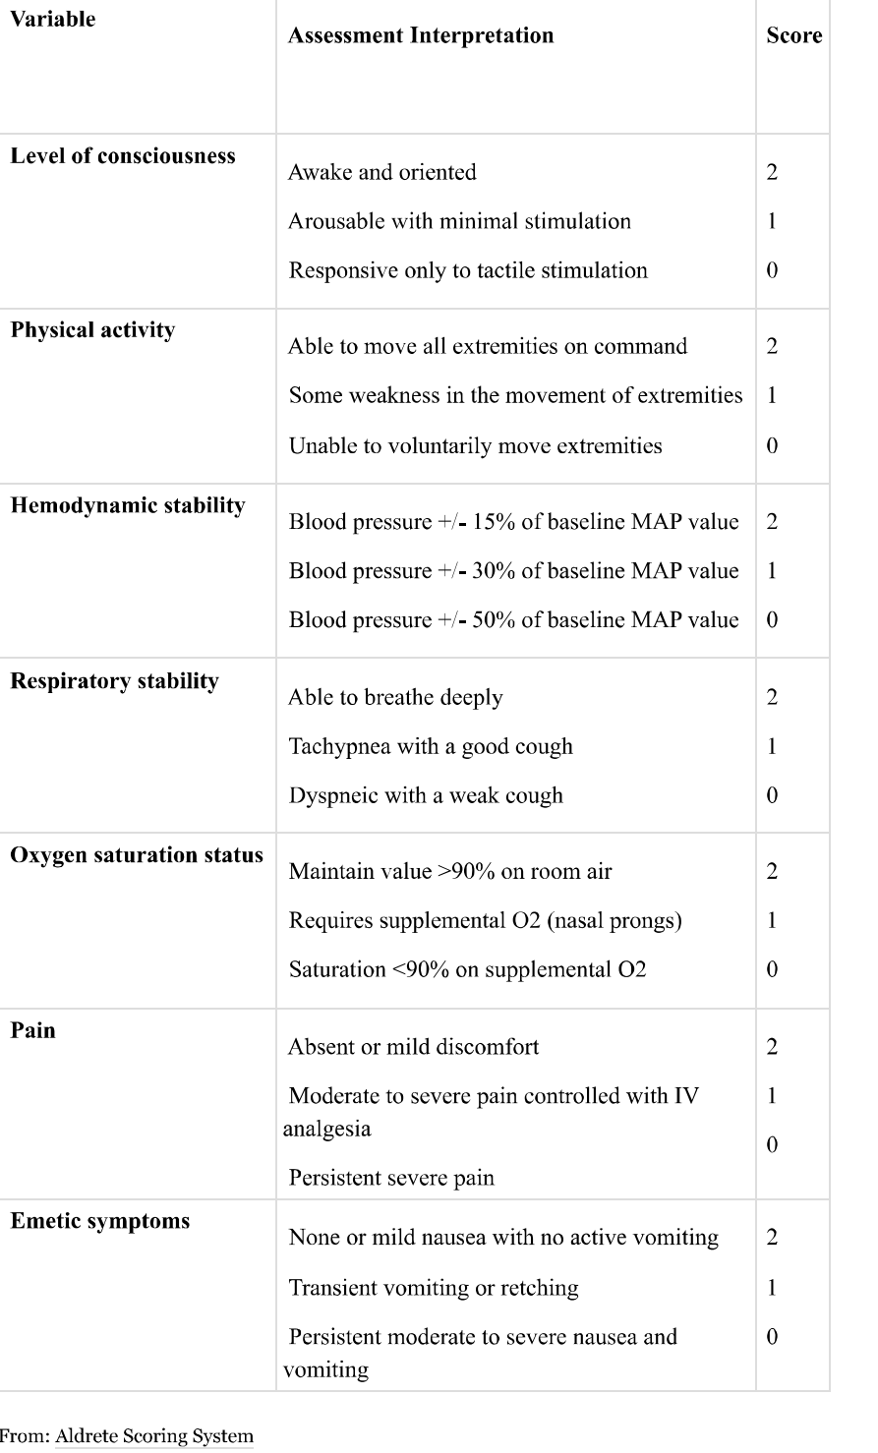

Slide 9
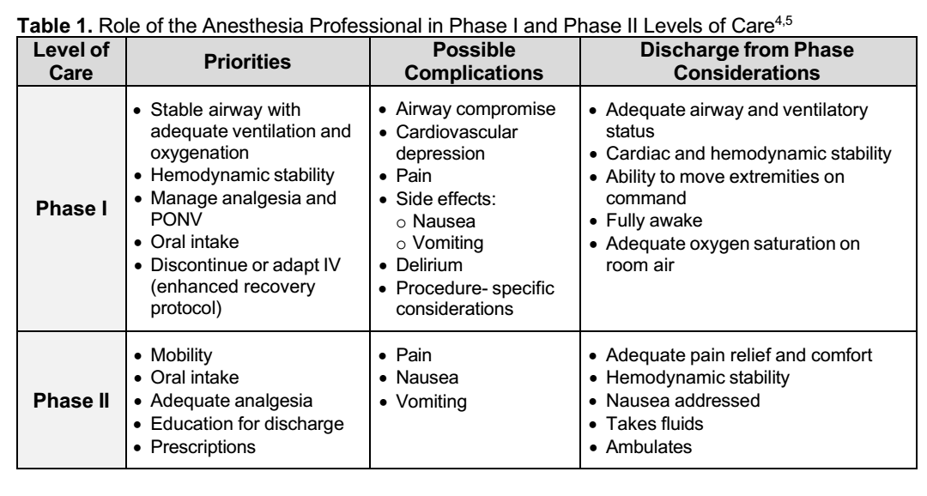

Slide 10
Phase III recovery (extended): designated for patients requiring continued observation in preparation for discharge from the hospital or transfer to a general care unit
This phase is for patients who have met criteria to leave Phase I, but are not able to go to another location (insufficient inpatient beds)
These patients are assessed and managed as inpatients
A staffing include the ratio of one nurse to 3 to 5 patients in this final stage of recovery before discharge

Slide 11
Post-anesthesia care unit (PACU)
A specialized area for observation, follow-up, treatment, recovery and discharge of postoperative patients
Recovery of patients after procedures requiring anesthesia or sedation is most commonly performed in the PACU or recovery room
The PACU should be located near the operating rooms and oﬀ-site invasive procedure areas.
A central location in the OR itself is desirable, as it ensures that the patient can be rushed back to surgery, if needed, or that members of the OR team can quickly respond to urgent or emergent issues

Slide 12
An open-ward design facilitates observation of multiple patients simultaneously
A ratio of 1-2 PACU beds per operating room is customary, although this number will vary depending on the respective OR suite’s case volume, variety of surgical procedures, and patient acuity
Each patient space should be well-lighted and large enough to allow easy access to patients in spite of poles for intravenous infusion pumps, a ventilator, or radiographic equipment

Slide 13
The PACU should be well staffed; inadequate staffing is often cited as a major contributing factor in PACU mishaps
The staff assigned to the PACU must have a thorough understanding of the surgeries performed and be familiar with potential postoperative complications associated with the anesthetic provided and the surgical procedure
The PACU should be staﬀed by trained nurses, anesthesia team and other supportive personnel.

Slide 14
Immediately after surgery, all patients not returning to a special care area (ICU or HDU) need to be nursed by those trained and practiced in postoperative recovery
The anesthetist should also retain a responsibility for patients during their stay in the postanaesthesia care unit (PACU)
Patients in the PACU should be under the medical direction of an anesthesiologist, who must be immediately available to respond to urgent or emergent patient care problem

Slide 15
The patient management in the PACU should reﬂect a coordinated eﬀort involving anesthesiologists, surgeons, nurses, respiratory therapists, and appropriate consultants
The anesthesia team emphasizes management of pain, airway, cardiac, pulmonary, and metabolic problems, whereas the surgical team generally manages any problems directly related to the surgical procedure itself

Slide 16
The PACU should be well equipped with all essential utilities for patient care
Many PACU incidents leading to serious morbidity or mortality are related to inadequate monitoring
Minimum monitoring standards should be maintained until the patient has fully recovered from anesthesia
Standard monitors, oxygen sources, airway equipment, PPV sources, invasive monitors, Emergency carts (equipment and medications)

Slide 17
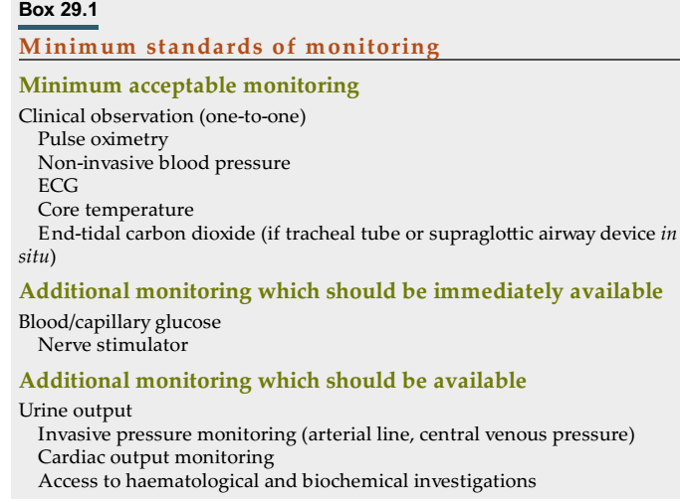

Slide 18
Depending on the case load, two PACU beds per theatre are normally required to allow safe recovery of patients and discharge to the ward without delays to theatre schedules
Each bed space should be fitted with 12 electrical socket outlets (six on each side of the bed), one oxygen and one medical air pipeline outlet, two vacuum outlets, an adjustable examination light, an emergency call system, physiological monitors with a display screen and a recording system for patient data

Slide 19
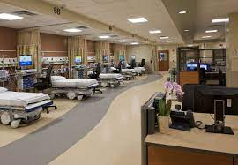

Slide 20
ASA standards of post anesthesia care
Should apply to post anesthesia care in all locations and intended to encourage patient care
The five standards developed by “committee on standards and practice parameters” and last amended on 2019, a subject of revision as a time goes based technological advancement

Slide 21
Standard I:All patients who received GA, RA or MAC shall receive appropriate post anesthetic management
The medical aspects of PACU care shall be governed by policies and procedures which have been reviewed and approved by the Department of Anesthesiology
The design, equipment and staffing of the PACU shall meet requirements of the facility’s accrediting and licensing bodies

Slide 22
Standard II:A patient transported to the PACU shall be accompanied by a member of the anesthesia care team who is knowledgeable about the patients’ condition
The patient shall be continually evaluated and treated during transport with monitoring and support appropriate to the patient’s condition

Slide 23
Standard III: upon the arrival to the PACU, the patient shall be re-evaluated and a report provided to the responsible PACU nurse by the anesthesia team who gave care to the patient
The patient’s status on arrival in the PACU shall be reported and documented
Information concerning the preoperative condition and the surgical/anesthetic course shall be transmitted to the PACU nurse
The member of the Anesthesia Care Team shall remain in the PACU until the PACU nurse accepts responsibility for the nursing care of the patient.

Slide 24
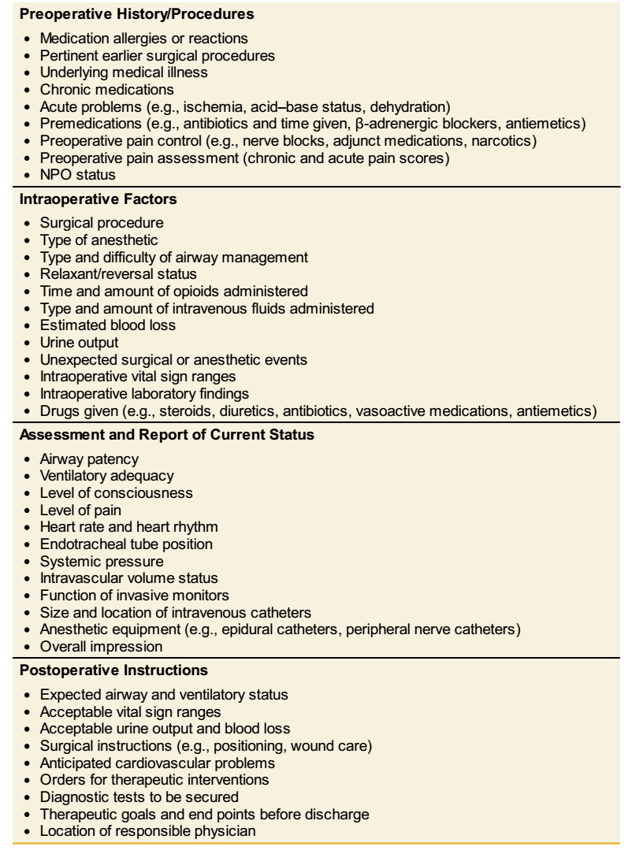

Slide 25
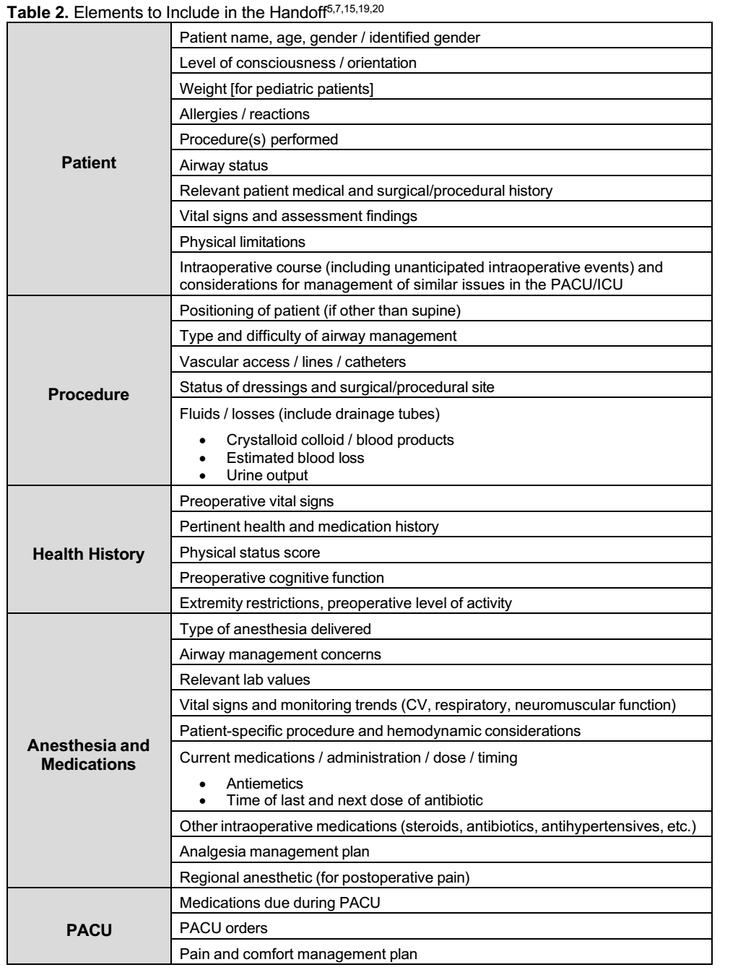

Slide 26
Standard IV: the patients condition shall be continually evaluated in the PACU
The patients’ oxygenation, ventilation, circulation, consciousness, and temperature shall be observed and monitored continually.
An accurate written report of the PACU period shall be maintained. Use of an appropriate PACU scoring system is encouraged for each patient on admission, at appropriate intervals prior to discharge and at the time of discharge
General medical supervision and coordination of patient care in the PACU should be the responsibility of an anesthesiologist
There shall be a policy to assure the availability in the facility of a physician capable of managing complications and providing cardiopulmonary resuscitation for patients in the PACU

Slide 27
Standard V: there should be a physician who is responsible for the discharge of the patients from the PACU
When discharge criteria are used, they must be approved by the Department of Anesthesiology and the medical staff. They may vary depending upon whether the patient is discharged to a hospital room, to the Intensive Care Unit, to a short stay unit or home
In the absence of the physician responsible for the discharge, the PACU nurse shall determine that the patient meets the discharge criteria. The name of the physician accepting responsibility for discharge shall be noted on the record.

Slide 28
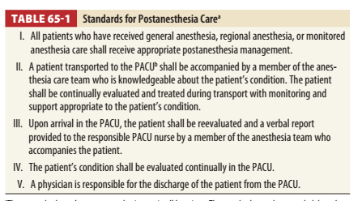

Slide 29
Managing and monitoring postoperative patients
Recovery from general or regional anesthesia is a time of great physiological stress
With continued demand to increase overall health care efficiency, caution must be taken to provide the most appropriate care for each patient
Patients must be carefully evaluated to determine which level of care is appropriate
Each patient should have an individualized postanaesthesia care plan, which should be communicated in both written and verbal formats.

Slide 30
Mechanisms for the early identification of patients requiring a higher level of care should be in place, as should the requirement for specialist postoperative intervention.
Triage should be based on clinical condition, length/type of procedure and anesthetic, and the potential for complications that require intervention
An individual patient undergoing a specific procedure or anesthetic should receive the same appropriate level of postoperative care whether the procedure is performed in a hospital OR, an ambulatory surgical center, and endoscopy room

Slide 31
There are four recognized levels of postoperative care:
Level 0: Ward – basic observations
Level 1: Enhanced ward – more frequent observations for patients at risk of deterioration or requiring basic resuscitation
Level 2: HDU – detailed observation or intervention, and patients requiring single-organ support, excluding tracheal intubation/ventilation
Level 3: ICU – complex patients requiring tracheal intubation/ventilation or support of more than one organ system

Slide 32
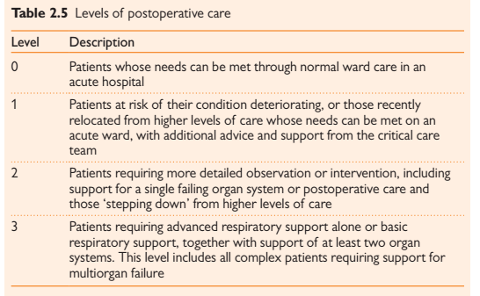

Slide 33
Every patient admitted to a PACU should have vital signs, airway patency, peripheral oxygen saturation, temperature, neuromuscular functions, respiratory rate/character, mental status, UOP, bleeding and drainage outputs and level of pain recorded and periodically monitored
The frequency and duration of monitoring is dictated by the clinical status of the patient
A periodic recording every 5 minutes for the first 15 minutes and every 15 minutes thereafter is a minimum

Slide 34
All patients recovering from general anesthesia must receive supplemental oxygen and pulse oximetry monitoring during emergence because transient hypoxemia can develop even in healthy patients
Patients should generally be nursed in the back-up position, whenever possible, to optimize oxygenation (LOC must be considered)

Slide 35
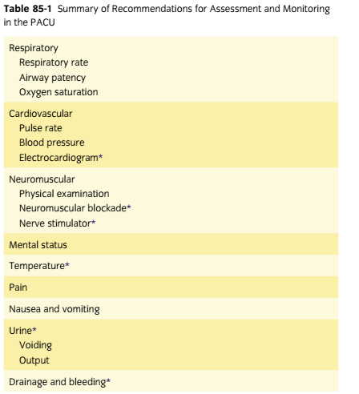

Slide 36
Fluid management
All patients in the PACU must be evaluated for the adequacy of the intraoperative fluid resuscitation
Postoperative fluid management plays a key role in providing adequate tissue perfusion, stable hemodynamics and reducing morbidities related with hemodynamics.
Management of postoperative fluid therapy should be done considering both patients’ status and intraoperative events
Types of the fluids, amount of the fluid given and timing of the administration are the main topics that determine the fluid management strategy

Slide 37
Presence of indicators for additional fluid requirement such as hypotension, tachycardia, and low urine output should be promptly looked for.
However until proven otherwise, bleeding must be the primary concern in postoperative hypotension
The approach to fluid resuscitation can vary according to the clinical situation and institutional protocol
In general, goal directed strategy for fluid resuscitation in paramount important

Slide 38
Pain management
Pain is defined as unpleasant sensory response related actual or potential tissue damage.
Postoperative pain is a complex physiologic reaction to tissue injury and patients may encounter acute pain of various degree in PACU
Postoperative pain is directly related to patient satisfaction, which has evolved into an important measure for high-quality health care
Appropriate management of acute perioperative pain using multimodal opioid-sparing analgesia is therefore crucial

Slide 39
Inadequate relief of postoperative pain has adverse physiologic effects that can contribute to significant morbidity and mortality, resulting in the delay of patient recovery and return to daily activities
In addition, poor postoperative pain control contributes to patient dissatisfaction with the surgical experience and can cause to a chronic pain condition.
Surgical procedures that can be associated with chronic painful conditions include amputation of a limb, lateral thoracotomy, inguinal herniorrhaphy, abdominal hysterectomy, saphenous vein stripping, open cholecystectomy, nephrectomy, and mastectomy

Slide 40
Factors that positively correlate with increased postoperative pain include but not limited to:
preoperative opioid intake
increased body mass index
anxiety
depression
pain intensity level
characteristics of fibromyalgia
duration of surgery

Slide 41
Most postoperative pain is nociceptive in character, but there are a small percentage of patients who can experience neuropathic pain postoperatively.
Neuropathic pain is a result of accidental nerve injury secondary to cutting, traction, compression, or entrapment
It is critical to recognize this fact because patients with neuropathic pain are at increased risk of progressing to a chronic pain state

Slide 42
Understanding of the epidemiology and pathophysiology of postoperative pain has increased the use of multimodal management of pain in an effort to improve patient comfort, decrease perioperative morbidity, and reduce cost

Slide 43
Nociceptive pain responds best to opioids, NSAIDs, para-aminophenol agents, and regional anesthesia techniques
Preventive analgesia use includes any anti nociceptive regimen delivered at any time during the perioperative period that will attenuate pain-induced sensitization
The goal of preventive analgesia is to block the development of sustained pain

Slide 44
In order for preventive analgesia to be successful, three critical principles must be adhered to:
The depth of analgesia must be adequate enough to block all nociceptive input during surgery
The analgesic technique must be extensive enough to include the entire surgical field
The duration of analgesia must include both the surgical and postsurgical periods

Slide 45
Multimodal Approach to Perioperative Recovery
Pain management techniques are evolving from the use of single-modal analgesia to engaging the patient as a member of the care team in multimodal, opioid-sparing analgesia through enhanced recovery pathways
Post procedural or posttraumatic pain is best managed through this multimodal approach
Combination of interventional analgesic techniques (nerve blocks) and a combination of systemic pharmacologic therapies
The principles of this strategy include improvement of the patient's pain to instill a sense of control over their pain, enable early mobilization, allow early enteral nutrition, and attenuate the perioperative stress response

Slide 46
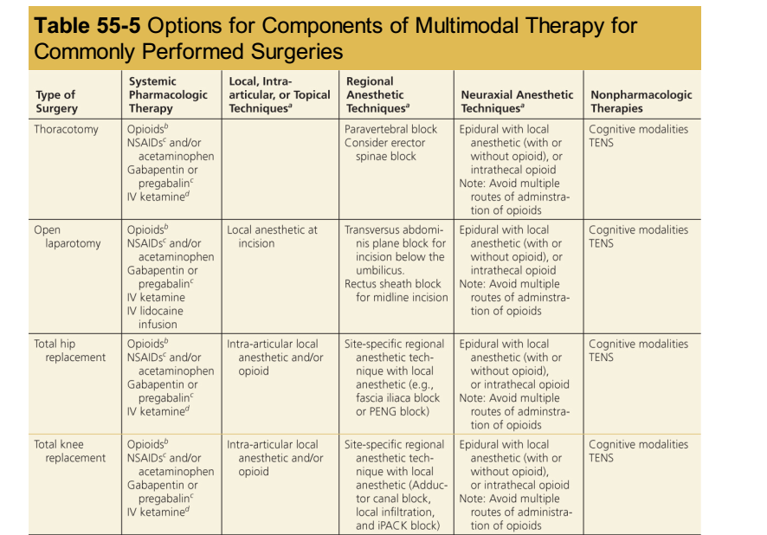

Slide 47
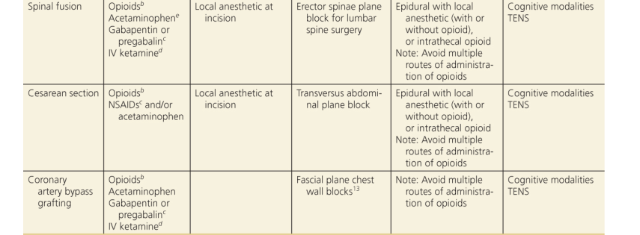

Slide 48
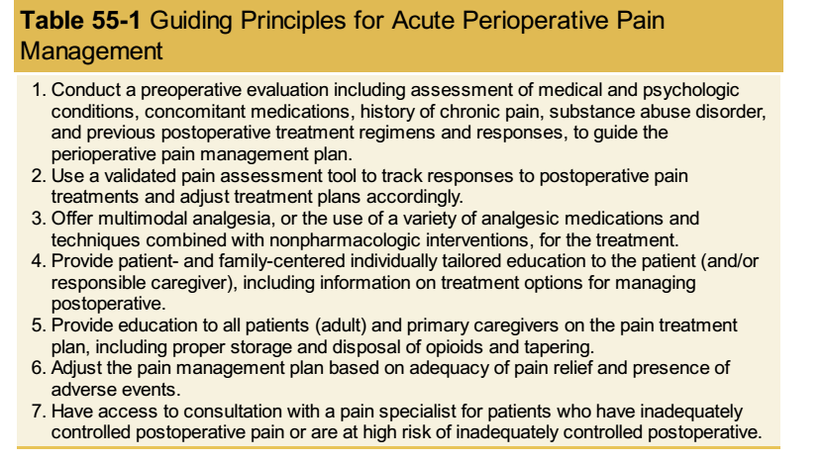

Slide 49
Oral medications are less desirable during perioperative time because of NPO status of the patients
Intermittent IV administration of small doses of opioids is commonly used to treat acute and severe pain in the PACU or ICU, where continuous nursing and monitoring are available
Rapid redistribution of the opioid produces a shorter duration of analgesia after a single IV administration than after an IM injection.

Slide 50
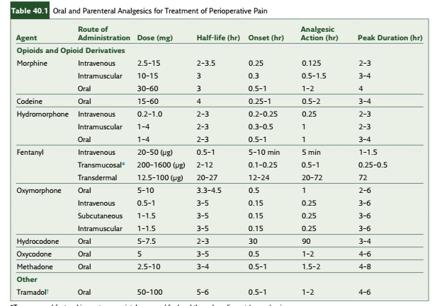

Slide 51
Patient-Controlled Analgesia (PCA) provides better analgesia with more safety, less total drug use, less sedation, fewer nocturnal sleep disturbances, and more rapid return to physical activity
PCAs are designed to safely allow patient-administered analgesic medications
Upon activation of the delivery system, limits are placed on the number of doses per unit of time that will be administered to the patient.

Slide 52
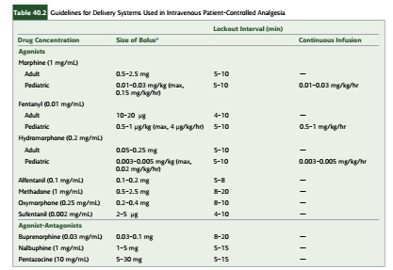

Slide 53
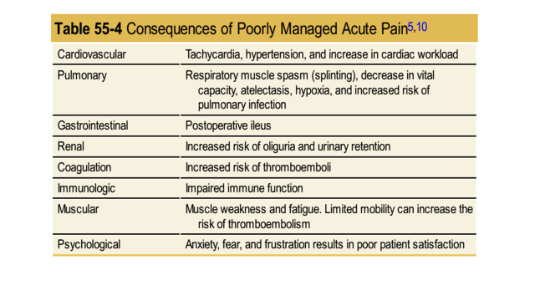

Slide 54
Assessment of Acute Pain
Effective treatment of acute pain requires assessment as well as vigilant reassessment to determine if the primary goals are met, adversity has occurred, or changes are necessary
The traditional verbal analog score (VAS) 0 to 10 scale (“on a scale of 0 to 10, with 0 being no pain and 10 being the worst pain you can imagine
Based on the reported pain score, the severity is categorized as mild, moderate and severe

Slide 55
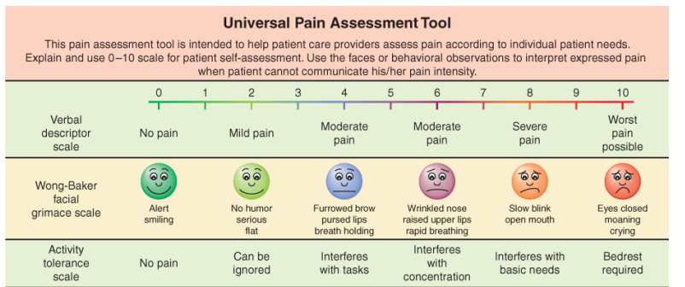

Slide 56
WHO ladder of pain management
The three main principles of the WHO analgesic ladder are: “By the clock, by the mouth, by the ladder”
To maintain freedom from pain, drugs should be given “by the clock” or “around the clock” rather than only “on demand” (i.e. PRN)
The frequency will depend on whether it is a long- or short-acting preparation

Slide 57
The oral route is usually the preferred route for ease of use in a variety of care settings
However, it may not be possible for all patients (e.g. end-of-life, unconscious, swallowing issues)
When the oral route is not feasible, the least invasive route should be considered (e.g. sub-lingual or sub-cutaneous, suppository)

Slide 58
The analgesic ladder developed by WHO consisted of three steps:
First Step - Mild pain: non-opioid analgesics such as nonsteroidal anti-inflammatory drugs (NSAIDs) or acetaminophen with or without adjuvants
Second Step - Moderate pain: weak opioids (hydrocodone, codeine, tramadol) with or without non-opioid analgesics and with or without adjuvants
Third Step - Severe and persistent pain: potent opioids (morphine, methadone, fentanyl, oxycodone, buprenorphine, tapentadol, hydromorphone, oxymorphone) with or without non-opioid analgesics, and with or without adjuvants

Slide 59
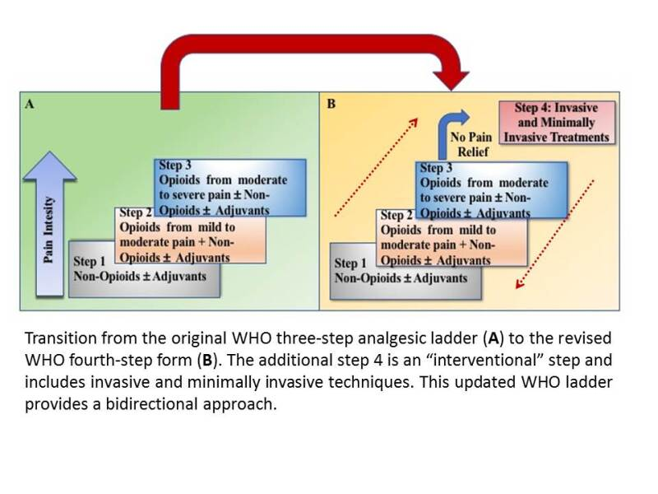

Slide 60
Discharge from PACU
All patients must be evaluated by a qualified anesthesia provider prior to discharge from the PACU
Whilst the responsibility for the safe and appropriate discharge of patients from PACU lies with the anesthetist, the adoption of strict discharge criteria enables this to be delegated to PACU staff.
The PACU nurses discharges without the presence of a qualified anesthesia provider if all PACU discharge criteria have been met.

Slide 61
Before discharge, patients should have been observed for respiratory depression for at least 20–30 min after the last dose of parenteral opioid
Other minimum discharge criteria for patients recovering from general anesthesia usually include the following:
Easy arousability
Full orientation
The ability to maintain and protect the airway
Stable vital signs for at least 15–30 min
The ability to call for help, if necessary
No obvious surgical complications (such as active bleeding)

Slide 62
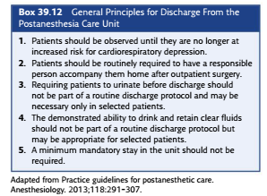

Slide 63
To standardize and facilitate discharge from PACU, several different scoring systems have been developed and updated over time
The most commonly used post anesthesia scoring system to monitor recovery from anesthesia is the Aldrete score, which was first described in 1970.
The original Aldrete score assigned a number of 0, 1, or 2 to five variables: activity, respiration, circulation, consciousness, and color
A score of 9 out of 10 was considered adequate for discharge from the PACU

Slide 64
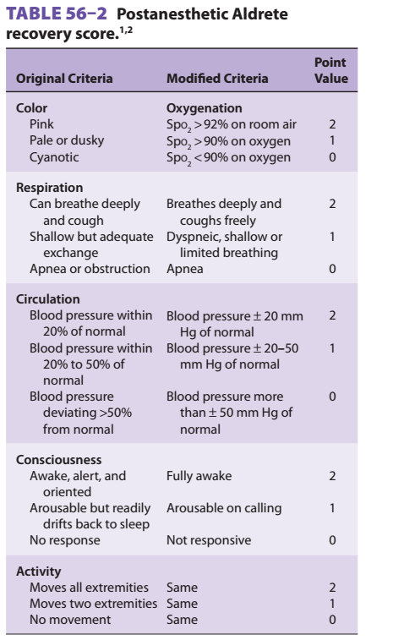

Slide 65
With the increase in number and complexity of outpatient surgeries, discharge criteria have been amended by various authors to include assessment of home readiness
the PADSS system (post anesthesia scoring system) was initially based on five criteria: vital signs, ambulation and mental status, pain and nausea/vomiting, surgical bleeding, and ﬂuid intake/output
The current version has been modified to separate pain and nausea/vomiting and to eliminate the need to urinate before discharge

Slide 66
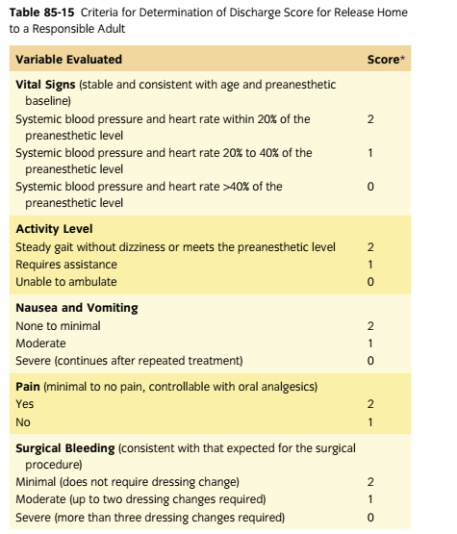

Slide 67
Postoperative evaluation
Post anesthesia follow-up requires a written follow-up that is performed by an individual that is qualified to administer anesthesia
The timeframe starts as soon as the patient arrives in the recovery area or ICU
The evaluation should be performed only after the patient has sufficiently recovered from anesthesia and is able to participate and answer questions or perform simple tasks

Slide 68
The post anesthesia evaluation must contain the following elements:
Respiratory function: respiratory rate, airway patency, and oxygen saturation
Cardiovascular function, including pulse rate and blood pressure
Mental status
Temperature
Pain
Nausea and vomiting
Postoperative hydration

Slide 69
Common postoperative complications and management
Emergence from general anesthesia and surgery may be accompanied by a number of physiologic disturbances that affect multiple organ systems
Patients may encounter various issues that may range from very common events, such as inadequate analgesia, to less frequently experienced clinical problems such as negative pressure pulmonary edema
Postoperative complications are common and have an enormous impact on individual patient welfare and healthcare costs

Slide 70
Anesthetists are well placed to work with surgical colleagues on the implementation of strategies to minimize complications and the development of novel approaches for patient care
Various methods has been used to identify postoperative complications in clinical practice
There were three popular methods in use to identify the presence of postoperative complications

Slide 71
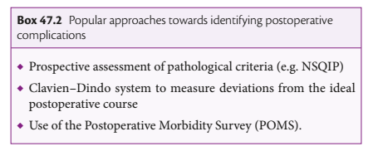

Slide 72
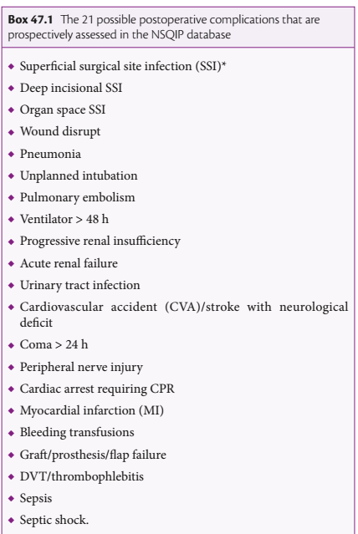

Slide 73
Clavien-dindo system; utilizes treatments that are instituted for ‘deviations from the ideal postoperative course
Complications are graded on a severity scale from I to IV, ranging from mild deviations requiring additional medication to severe deviations requiring organ support
This system was a well validated in large cohorts and believed to have a good inter-observer reliability and increasing acceptance

Slide 74
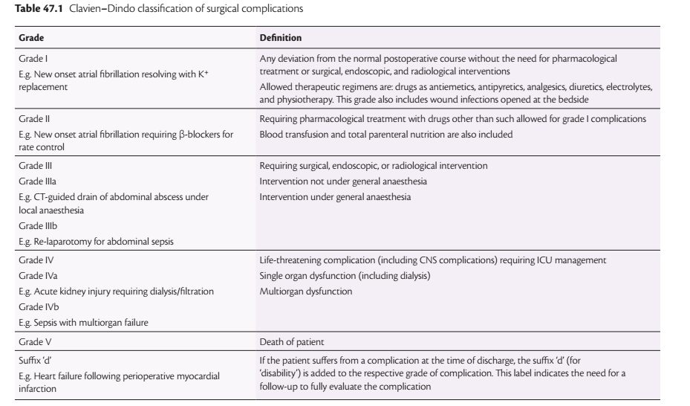

Slide 75
Postoperative Morbidity Survey (POMS):requires objective ‘Yes or No’ answers to questions interrogating morbidity in nine domain
Its purpose is to measure postoperative occurrences that prolong the length of hospital stay, largely based on the treatments instituted
Thought to be a sensitive approach that detect a minor perturbations in organ systems and features that prolong the postoperative course
POMS demonstrates excellent inter-observer reliability and is useful for comparing outcomes across institutions

Slide 76
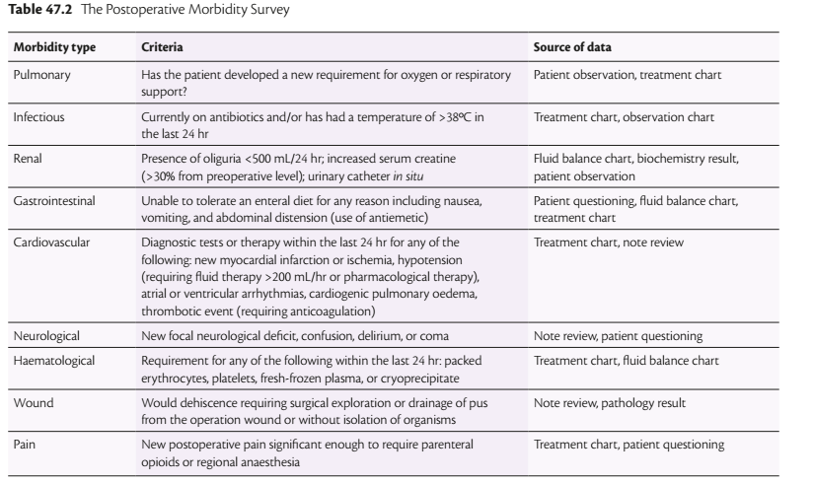

Slide 77
Respiratory complications
Most surgical patients arrive in the PACU after extubation in the OR with supplemental oxygen provided
Respiratory problems are the most frequently encountered serious complications in the PACU
Patients in in early postoperative period develop postoperative hypoxemia of different etiologies and should be closely observed and monitored
Mechanical, hemodynamic, and pharmacologic factors related to surgery and anesthesia impair ventilation, oxygenation, and airway maintenance

Slide 78
Risk factors for postoperative pulmonary complications include preexisting patient conditions such as COPD, OSA, extreme age, tobacco use, high ASA status, obesity, asthma and malnutrition as well as surgical factors
The predominant issues include inadequate oxygenation or ventilation, upper airway obstruction, laryngospasm, and aspiration

Slide 79
Inadequate Postoperative Ventilation
Residual effects of IV and inhalation anesthetics blunt the ventilatory responses to both hypercarbia and hypoxemia
In PACU patients, mild respiratory acidemia due to decreased minute ventilation is expected; thus elevated PaCO2 does not necessarily indicate inadequate postoperative ventilation

Slide 80
Inadequate ventilation should be suspected when
respiratory acidemia occurs coincident with tachypnea, anxiety, dyspnea, labored ventilation, or increased sympathetic nervous system activity
hypercarbia reduces the arterial pH below 7.30
PaCO2 progressively increases with a progressive decrease in arterial pH

Slide 81
Airway obstruction
Obstruction of the upper airway often occurs during recovery from anesthesia, and the recognition and management of airway compromise is a keystone of good anesthetic practice
Upper airway obstruction can arise in the pharynx from posterior tongue displacement or soft tissue collapse; the larynx from laryngeal edema, laryngospasm, or vocal cord paralysis; or the large airways from extrinsic compression
Partial obstruction of the airway is characterized by noisy ventilation, particularly on inspiration (stridor), tracheal tug, indrawing of the supraclavicular areas, and use of the accessory muscle of inspiration

Slide 82
Total obstruction is signaled by absent sounds of breathing and paradoxical movement of the chest wall and abdomen
possible causes include:
loss of pharyngeal muscle tone
problems within larynx
airway compression
foreign bodies

Slide 83
Pharyngeal obstruction
The most frequent cause of airway obstruction in the immediate postoperative period is the loss of pharyngeal muscle tone in a sedated or obtunded patient
The eﬀects of residual anesthetics, neuromuscular blockers, and opioids all contribute to the loss of pharyngeal tone in the PACU patient
The eﬀort to breathe against an obstructed airway is characterized by a paradoxical breathing pattern consisting of retraction of the sternal notch and exaggerated abdominal muscle activity

Slide 84
Remedies:
airway opening (jaw thrust, chin lift)
CPAP via facemask
oral or nasal airway
LMA insertion
reintubation

Slide 85
Laryngeal obstruction
obstruction at the level of larynx can be because of edema or laryngospasm
Laryngospasm refers to a sudden spasm of the vocal cords that completely occludes the laryngeal opening
it usually characterized by high pitched crowing noises, but may be silent with complete glottic closure.
Spasm of the vocal cords is more apt to occur following airway trauma, repeated instrumentation, or stimulation from secretions or blood in the airway.

Slide 86
It also can be caused by stimulation from an elongated uvula, may be sleep related, or may be stimulated by distal esophageal afferents
Although it is most likely to occur in the operating room at the time of tracheal extubation, patients who arrive in the PACU asleep after general anesthesia are also at risk
Partial laryngospasm allows for some air movement and may be difficult to distinguish from other causes of upper airway obstruction
Complete laryngospasm prevents all air movement and is a prominent cause of negative pressure pulmonary edema

Slide 87
Patients who smoke or are chronically exposed to smoke have irritable airway conditions, have copious secretions, or have undergone upper airway surgery are at higher risk
Remedies:
removing the noxious stimulus
jaw thrust
positive pressure ventilation (10-20 mmHg)
IV propofol (1mg/kg)
IV suxamethonium (0.1-0.5 mg/kg)

Slide 88
Laryngeal or subglottic edema can create airway obstruction occasionally after tracheal intubation and may result in severe obstruction, particularly in a child
Multiple or traumatic intubation attempts, prone or Trendelenburg intraoperative positioning, large volume fluid resuscitation, upper airway and major neck surgery, and the effects of prior neck radiation are predisposing factors
Soft-tissue edema worsens airway obstruction, especially in children and adults recovering from procedures on the neck

Slide 89
Although facial and scleral edema is an important physical sign, significant edema of pharyngeal tissue may not be accompanied by visible external signs
Treatment depends on the severity of the obstruction; immediate tracheal reintubation may be required if obstruction is complete
Partial obstruction may subside if the patient is treated with heated humidified gases

Slide 90
Treatment of partial airway obstruction resulting from airway edema includes head-up positioning to promote venous drainage and administration of steroids and nebulized epinephrine
Parenteral administration of corticosteroids, epinephrine nebulization, and inhalation of a helium-oxygen mixture are potentially effective
Patients with severe AWO may not be benefit from PPV with mask
Equipment and personnel necessary for emergency cricothyroidotomy or tracheostomy should be available

Slide 91
Foreign body and external compression
Acute extrinsic neck compression from an expanding neck hematoma can be life-threatening
Neck hematomas can develop after carotid endarterectomy, thyroid or parathyroid surgery, or other neck surgery
The pressure caused by an expanding hematoma within the neck tissue planes causes obstruction of venous and lymphatic drainage and massive edema

Slide 92
Patients complain of local pain and pressure, dysphagia, and variable degrees of respiratory distress
A rapidly expanding hematoma can make emergency reintubation extremely difficult.
Opening the wound at the bedside can relieve tissue congestion and improve airway patency.
Definitive treatment usually requires returning to the operating room for hematoma evacuation and exploration

Slide 93
Retained surgical packs, dislodgement, and aspiration of teeth or dentures can result in airway obstruction
The presenting symptoms of foreign body aspiration may range from none to severe airway obstruction
Bronchoscopy is used to confirm the diagnosis and retrieve the object
Occasionally a cooperative mature patient can be examined under local anesthesia with fiber optic bronchoscopy however general anesthesia is typically required

Slide 94
Alveolar Hypoventilation And V/Q Mismatch
Hypoventilation results in an increase in PaCO2 and a decrease in alveolar oxygen tension (PaO2)
In the immediate postoperative period, the residual eﬀects of inhaled anesthetics, opioids, and sedative-hypnotics can significantly depress this ventilatory response to carbon dioxide
The presence of restrictive pulmonary conditions, such as preexisting chest wall deformity, postoperative abdominal binding, or abdominal distention, can also contribute to inadequate ventilation

Slide 95
Ventilation-perfusion (V̇/Q̇) abnormalities are the most common cause of hypoxaemia in the recovery room
In the PACU, the residual eﬀects of inhaled anesthetics and vasodilators used will blunt hypoxic pulmonary vasoconstriction and contribute to arterial hypoxemia
Causes of postoperative pulmonary shunt include atelectasis, pulmonary edema, gastric aspiration, pulmonary emboli, and pneumonia

Slide 96
Atelectasis is probably the most common cause of pulmonary shunting in the immediate postoperative period
Administration of supplemental oxygen, external stimulation of the patient to wakefulness, pharmacologic reversal of opioid or benzodiazepine eﬀect are known to be effective
Mobilization of the patient to the sitting position, incentive spirometry, and positive airway pressure by facemask can be eﬀective in treating atelectasis

Slide 97
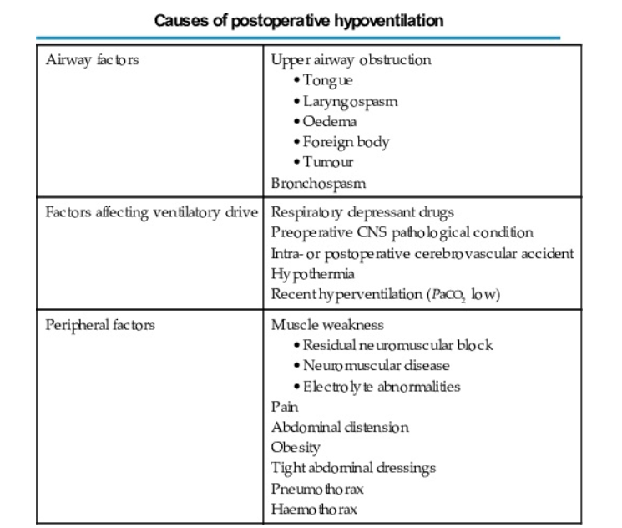

Slide 98
Oxygen therapy:
Hypoxemia may occur to some degree in any patient during the early recovery period
The majority of patients recovering after anesthesia require only a modest increase in FIO2 to overcome the combined effects of mild hypoventilation, diffusion hypoxia and some degree of increased V̇/Q
Consequently, all patients should receive additional oxygen for at least the first 10 min after general anesthesia has been discontinued
The choice of oxygen delivery system in the PACU is determined by the degree of hypoxemia, the surgical procedure, and patient compliance

Slide 99
Patients who are status post head and neck surgery may not be candidates for facemask oxygen owing to the risk of pressure necrosis on incision sites and microvascular muscle ﬂaps
Oxygen therapy should be continued for a longer period in the presence of any of the following conditions:
• Hypotension
• Ischemic heart disease
• Reduced cardiac output
• Anemia
• Obesity
• Shivering
• Hypo- and hyperthermia
• Pulmonary edema
• Airway obstruction

Slide 100
The delivery of oxygen through a traditional nasal cannula with bubble humidifier is usually limited to a maximum ﬂow of 6 L/min to minimize the discomfort and complications

Slide 101
Cardiovascular Complications
In the PACU, some reflexes previously blunted by general anesthetics, sedatives, and opioids return toward baseline, revealing an unexpected cardiovascular compromise
Hemodynamic compromise in the PACU patient manifests in a number of ways (systemic hypertension, hypotension, tachycardia, or bradycardia) alone or in combination
Postoperative systemic hypertension and tachycardia are associated with an increased risk of unplanned critical care admission and a higher mortality than hypotension and bradycardia

Slide 102
Hypertension
Arterial hypertension is a common complication in the early postoperative period
Patients with a history of essential hypertension are at greatest risk for significant systemic hypertension in the PACU
The surgical procedures most commonly associated with postoperative hypertension are carotid endarterectomy and intracranial operations
A significant number of patients, especially those with a known history of hypertension, will require pharmacologic blood pressure control in the PACU
Notes:
Hypertension is a very common problem in the postoperative period.
Typical onset is early, usually within 2 hours after surgery, and generally
requires treatment for ≤6 hours. It occurs most commonly after vascular,
head and neck, and neurosurgical procedures

Slide 103
Hypertension results in increased cardiac work and myocardial oxygen consumption and may result in myocardial ischemia, MI , left ventricular failure or cerebral hemorrhage
A significant number of patients, especially those with a known history of hypertension, will require pharmacologic blood pressure control in the PACU
The decision to treat hypertension requires consideration of the patient’s baseline blood pressure, coexisting diseases, and perceived risk of complications

Slide 104
Short-term control of blood pressure in the PACU is best accomplished with drugs that have a rapid onset and possess a short to intermediate duration of action
Intravenous agents such as labetalol, esmolol, propranolol, and hydralazine are commonly used for short-term control of blood pressure
For persistent or refractory hypertension, continuous infusions of vasodilators such as nitroprusside, nitroglycerin, nicardipine, or fenoldopam may be required

Slide 105
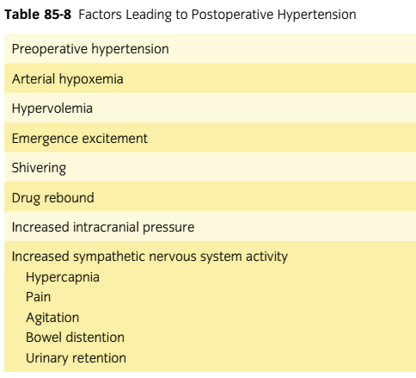

Slide 106
Hypotension
Systemic hypotension in the PACU is often due to decreased intravascular ﬂuid volume and preload
Up to 20% reduction in MAP from baseline is tolerated well, except by older patients or those with myocardial disease.
Common causes of decreased IV volume in the immediate postoperative period include third-space translocation of ﬂuid, inadequate intraoperative ﬂuid replacement (major intra-abdominal procedures or preoperative bowel preparation), and loss of SNS tone as a result of neuraxial blockade

Slide 107
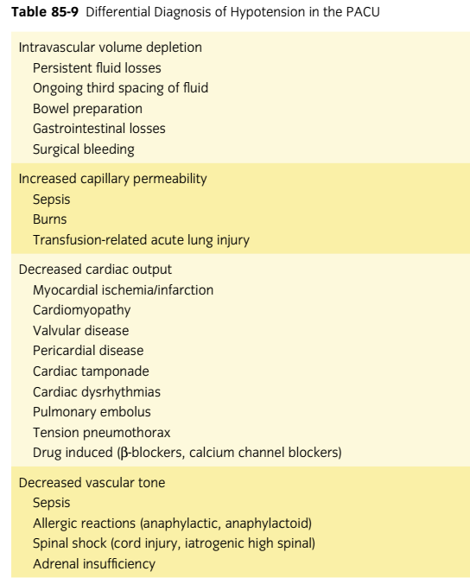

Slide 108
Ongoing bleeding should be ruled out in hypotensive patients who have undergone a surgical procedure in which significant blood loss is possible
In most patients, the situation usually resolves comprises elevation of the legs and administration of appropriate crystalloid or colloid solutions
Infusion of 7–10ml/kg i.v. crystalloid or colloid is usually effective in restoring normotension if there is concern

Slide 109
Arrhythmia
Arrhythmias are common during and immediately after anesthesia, although the majority are benign and require no treatment
The reported incidence of arrhythmias following major noncardiothoracic surgery ranges from 4% to 20%, depending on the type of surgery performed, the degree of cardiac monitoring undertaken, and the type of arrhythmia studied
Most of the arrhythmias are atrial in origin, and most perioperative arrhythmias are benign

Slide 110
The incidence of new postoperative atrial dysrhythmias may be as high as 10% after major no cardiothoracic surgery
The clinical significance of an arrhythmia depends on the patient’s underlying cardiac function

Slide 111
Ventricular arrhythmias consist of ventricular premature beats, ventricular tachycardia, and ventricular fibrillation
Premature ventricular contractions (PVCs) and ventricular bigeminy occur commonly in the PACU
PVCs most often reﬂect increased sympathetic nervous system stimulation that may accompany tracheal intubation, pain, and transient hypercapnia

Slide 112
Tachyarrhythmia's are classified according to their anatomic origin as supraventricular or ventricular.
Supraventricular arrhythmias include sinus tachycardia, atrial fibrillation and flutter
Sinus tachycardia is the most common arrhythmia in the immediate postoperative period. Increased sympathetic discharge resulting from pain, hypovolemia, anemia, anxiety, hypoxia, and hypercarbia are common causes

Slide 113
Sinus tachycardia usually is benign; however, it may precipitate myocardial ischemia in a patient with coronary artery disease
Treatment of the underlying cause(s) (eg, analgesics for pain, fluids for hypovolemia, sedatives for anxiety) usually is adequate for resolution.
In patients at risk for myocardial ischemia, β-blockade usually is effective in reducing the heart rate

Slide 114
Supraventricular tachyarrhythmias are more common after thoracic surgery than after other types of noncardiac surgery with a reported incidence of ≥13%
In these patients, preoperative β-blockers should be continued postopratively, and prophylaxis with calcium channel blockers significantly reduces the occurrence of atrial fibrillation
Atrial fibrillation is the most common supraventricular arrhythmia after either cardiac or noncardiac surgery and has the greatest potential for serious consequences

Slide 115
In hemodynamically stable patients, β-blockers, calcium channel blockers, or amiodarone are alternatives for rate control
Bradycardia usually is associated with sinus node or atrioventricular node dysfunction
In the postoperative setting, bradycardia is often due to increased vagal tone as a result of hypoxemia, pain, nausea, drugs (eg, neostigmine, β-blockers, dexmedetomidine or opioids) or the effects of neuraxial anesthesia

Slide 116
Sinus bradycardia can be a normal rhythm in a young healthy patient. Bradycardia without hypotension usually is benign and no treatment is necessary
If bradycardia is associated with hemodynamic compromise (hypotension, low cardiac output), treatment with antimuscarinic agents (glycopyrrolate or atropine) or β-agonists (ephedrine) can restore normal sinus rhythm

Slide 117
Renal complications
The diﬀerential diagnosis of postoperative renal dysfunction includes prerenal, intrarenal, and postrenal causes
The cause is multifactorial, with a preexisting renal insufficiency that is exacerbated by an intraoperative insult
Oliguria, defined as a urine output of <0.5 mL kg-1 hour -1, is a frequent postoperative occurrence
In the PACU, diagnostic eﬀorts should focus on identification and treatment of the readily reversible causes of oliguria (urine output < 0.5 mL/kg/hr).

Slide 118
The most common cause of oliguria in the immediate postoperative period is depletion of intravascular ﬂuid volume.
In this regard, a ﬂuid challenge (500 to 1000 mL of crystalloid) is usually eﬀective in restoring urine output
Volume resuscitation to maximize renal perfusion is particularly important to prevent ongoing ischemic injury and the development of acute tubular necrosis
The stress response of surgery also increases antidiuretic hormone (ADH), which can lead to decreased urine output

Slide 119
Persistent oliguria despite hydration, adequate perfusion pressure, and a furosemide challenge increases the likelihood of ATN, ureteral obstruction, renal artery or vein occlusion, or inappropriate ADH secretion
Postoperative bladder distension with associated urinary retention is common after anesthesia and surgery, reported incidence of between 5% and 70%
Urinary retention is common after urologic, inguinal, and genital surgery, and retention frequently delays discharge

Slide 120
Postoperative urinary retention can cause bladder over distention and permanent detrusor damage
The most significant predictive factors were age older than 50 years, intraoperative ﬂuid more than 750 mL, and bladder volume on entry to PACU greater than 270 mL

Slide 121
CNS complications
Many patients arrive in PACU with a depressed level of consciousness, ranging from mild disorientation to confusion, agitation, and coma
Patients sometimes exhibit inappropriate mental reactions, ranging from lethargy and confusion to physical combativeness and extreme disorientation
Usually this is attributable to the residual effects of anesthetic, sedative, and analgesic medications but may be the result of pathological conditions or deranged physiology

Slide 122
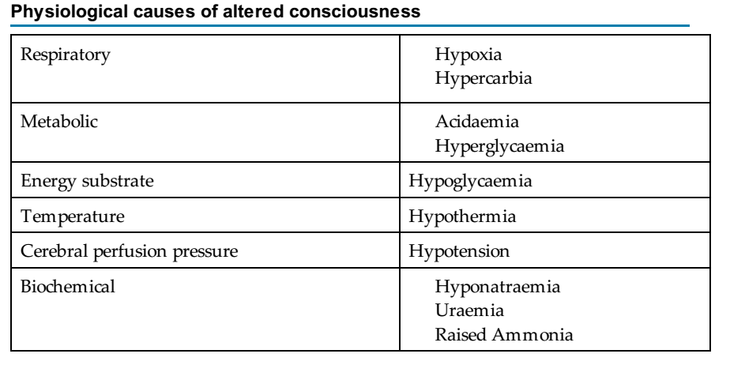

Slide 123
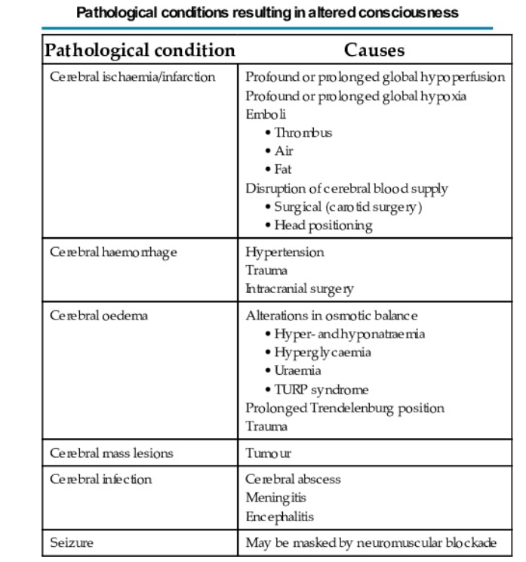

Slide 124
Postoperative delirium: is a transient, fluctuating disturbance of consciousness, attention, cognition, and perception
It is a common problem in the PACU with a reported incidence in adults of 3-5%
The delirious patient often is hypertensive and tachycardic, and the accompanying agitation can have serious consequences, including trauma; disruption of suture lines or surgical repairs; and accidental removal of catheters, tubes, and drains

Slide 125
Postoperative delirium is more common in the elderly and may delay recovery and prolong hospital stay
Other preoperative risk factors include organic brain disease, withdrawal from alcohol and sedatives, anxiety, and depression
Intraoperative risk factors include specific types of surgery (eg, cardiac, orthopedic, ophthalmologic) and administration of certain drugs (eg, anticholinergics, barbiturates, benzodiazepines).
Perioperative hypoxemia, hypotension, and sepsis are believed to be risk factors

Slide 126
The first priority in management of postoperative delirium is to rule out physiologic causes, including hypoxemia, hypotension, and acidemia.
Postoperative pain often plays a significant role and should be treated adequately.
Other treatable causes include hypoglycemia, electrolyte disturbances, sepsis, and sensory overload.
Bladder or gastric distension, or other nonsurgical pain sources (eg, corneal abrasion, infiltrated IV, poor positioning) should be excluded

Slide 127
Delirium should be treated supportively with verbal reassurance that the surgery is over and that the patient is doing well.
Elimination of environmental noise, allowing the patient to sleep, and reorientation efforts should be employed
Medications may be indicated in some circumstances; physostigmine is helpful when delirium is believed to be the result of central anticholinergic drugs such as scopolamine.
Haloperidol is the most widely used agent to treat severe agitation in the patient with delirium

Slide 128
Postoperative cognitive dysfunction (POCD ) can be usefully defined as a ‘long-term, possibly permanent, disabling deterioration in cognitive function following surgery
Patients exhibit fluctuations in level of consciousness and orientation, or deterioration of memory, mental functions, and acquisition of new information
The proposed causes of POCD include emboli, perioperative physiological disturbance and pre-existing cognitive impairment.

Slide 129
A number of risk factors for POCD have been identified
Early POCD
Increasing age
General anesthesia
Increasing duration of anesthesia
Respiratory complication
Lower level of education
Reoperation
Postoperative infection
Prolonged POCD (months)
Increasing age

Slide 130
Delayed awakening: after prolonged surgery and anesthesia, a response to stimulation in 60 to 90 minutes should occur
When delayed awakening occurs, it is important to evaluate the vital signs (systemic arterial blood pressure, arterial oxygenation, ECG, body temperature) and perform a neurologic examination

Slide 131
The major causes of delayed awakening after general anesthesia can be divided into three groups:
(1) pharmacologic effects,
(2) metabolic abnormalities
(3) neurologic injury

Slide 132
The residual effects of anesthetic drugs are the most common cause of delayed awakening.
It is important to obtain information on the patient’s preoperative level of consciousness, the timing and dosage of administered sedatives and opioids, and use of volatile anesthetics and muscle relaxants
Volatile anesthetics, especially those with high solubility, are more likely to result in delayed awakening after longer procedures or in obese patients

Slide 133
If residual eﬀects of opioids are a possible cause of delayed awakening, it is appropriate to administer carefully titrated intravenous doses of naloxone (20- to 40-µg increments in adults)
Physiostigmine may be eﬀective in reversing the central nervous system sedative eﬀects of anticholinergic drugs (especially scopolamine).
Flumazenil is a specific antagonist for the residual depressant eﬀects of benzodiazepines

Slide 134
Metabolic causes of delayed awakening include hypoxemia, hypercapnia, hepatic, renal or endocrine dysfunction, and glucose and electrolyte abnormalities
Hypoglycemia should be considered early, and 50% dextrose should be administered immediately if hypoglycemia is suspected.
Hyperglycemia, resulting in hyperosmolar coma or diabetic ketoacidosis, can reduce level of consciousness
Profound hypothermia (<33°C) can cause unconsciousness and increase the sedative effects of anesthetics. Extreme hypothermia can cause fixed dilated pupils and areflexia

Slide 135
If the diagnosis remains uncertain and delayance persists, neurologic consultation should be sought.
Urgent radiologic imaging [CT, MRI] can be performed to rule out an intracranial process, including stroke, hemorrhage, or hypoxic injury
Patients often are slow to awaken after long intracranial procedures; however, consideration should be given to the occurrence of complications such as ICH or increased ICP

Slide 136
PONV
Postoperative nausea and vomiting (PONV) is common following general anesthesia, occurring in 30% to 40% of all patients
Roughly, one third of patients who undergo inhalational anesthesia will develop PONV
Moreover, PONV occurs at home within 24 hr of an uneventful discharge (post discharge nausea and vomiting) in a significant number of ambulatory surgery patients

Slide 137
The etiology of PONV is usually multifactorial and associated with anesthetic and analgesic agents, the type of surgical procedure, and intrinsic patient factors, such as a history of motion sickness
It is also important to recognize that nausea is a common complaint reported at the onset of hypotension, particularly following spinal or epidural anesthesia
The consequences of PONV include delayed discharge from the PACU, unanticipated hospital admission, increased incidence of pulmonary aspiration, and significant postoperative discomfort.

Slide 138
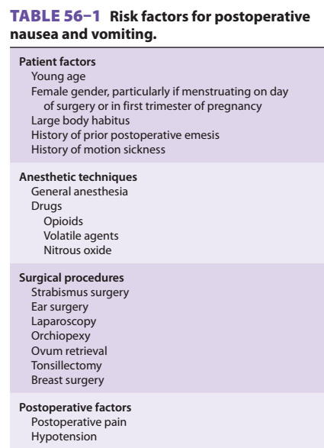

Slide 139
The ability to identify high-risk patients for prophylactic intervention can significantly improve the quality of patient care and satisfaction in the PACU
Prophylactic measures to prevent PONV include modification of anesthetic technique and pharmacologic intervention
Nonpharmacological prophylaxis against PONV includes ensuring adequate hydration (20 mL/kg) after fasting, and stimulation of the P6 acupuncture point (wrist)
Although prophylactic measures to prevent PONV are more eﬀective than rescue, a subset of patients will require treatment in the PACU even after appropriate prophylactic treatment

Slide 140
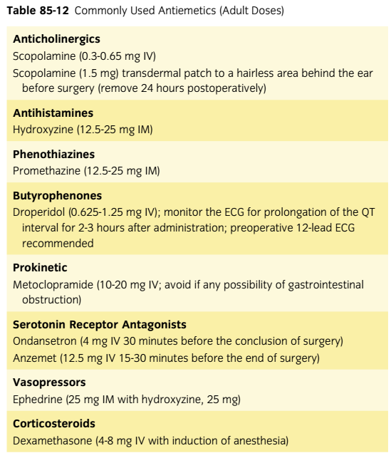

Slide 141
Shivering & Hypothermia
Postoperative shivering often occurs after general and epidural anesthesia
The incidence of postoperative shivering may be as high as 65% (range, 5% to 65%) after general anesthesia and 33% after epidural anesthesia
Postoperative shivering is usually, but not always, associated with hypothermia
The most important cause of hypothermia is a redistribution of heat from the body core to the peripheral compartments

Slide 142
Identified risk factors include male gender and the choice of induction agent; propofol is more commonly associated with shivering than pentothal is
Intense shivering causes precipitous rises in oxygen consumption, CO2 production, and cardiac output
It is associated with increased heart rate, systemic blood pressure, and intraocular pressure
These physiological eﬀects are often poorly tolerated by patients with preexisting cardiac or pulmonary impairment

Slide 143
Intervention includes the identification and treatment of hypothermia if present
Accurate core body temperatures can be most easily obtained at the tympanic membrane
Hypothermia should be treated with a forced-air warming device, or (less satisfactorily) with warming lights or heating blankets, to raise body temperature to normal

Slide 144
A number of opioids, ondansetron, and clonidine have been shown to be eﬀective in abolishing shivering once it starts, but in adults meperidine, 0.35 to 0.4 mg/kg (12.5 to 25 mg IV), is most commonly used

Slide 145
THE END!!!

